Slide 1
GMALL: Stewart Platform
MTE 380: Game Day Presentation
Gavin Grimm, Marvin Bullinger
Learn Group 2

Slide 2
Agenda
1
Team Objectives
2
What Makes Our Platform Unique?
3
Mechanical and Electrical Design and Iterrations
4
Software Design and Iterations
5
Lessons Learned

Slide 3

Design Goals
What Did We Hope to Achieve?
“Our goals for this project are to design a Stewart Platform that can balance balls of varying weight (ping pong ball, golf ball, ball bearing), for at least 15 seconds, while also being able to guide said balls along a set trajectory of a circle. The platform will need to maintain the balance of the balls after the introduction of physical disturbances.”

Slide 4
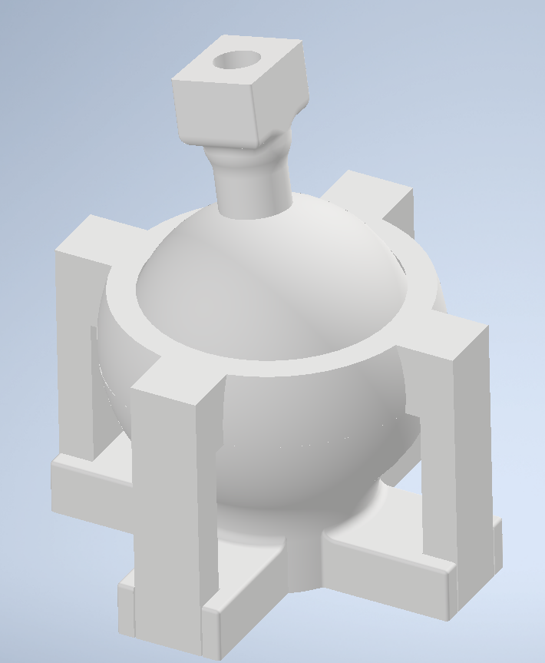
What Makes Our Platform Unique?
Standout Design Feature
3D Printed Ball Joint to Connect the Legs to the Platform:

Slide 5
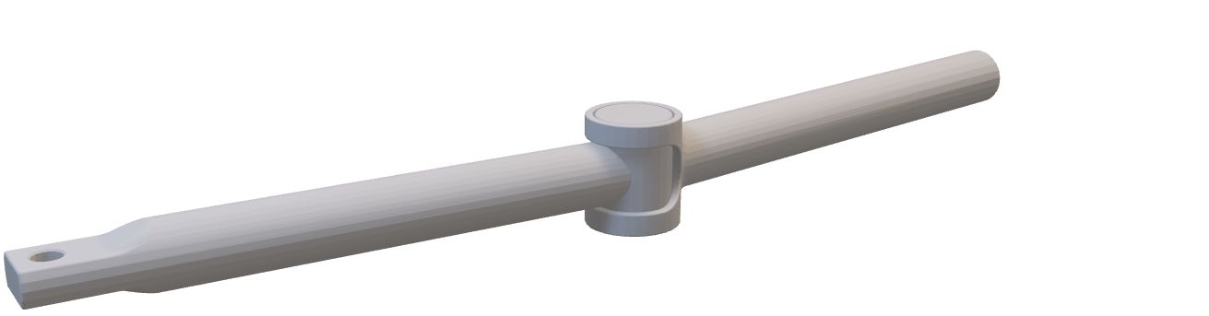
Mechanical Design and Iterations
Where we started – Iterration 1

Slide 6
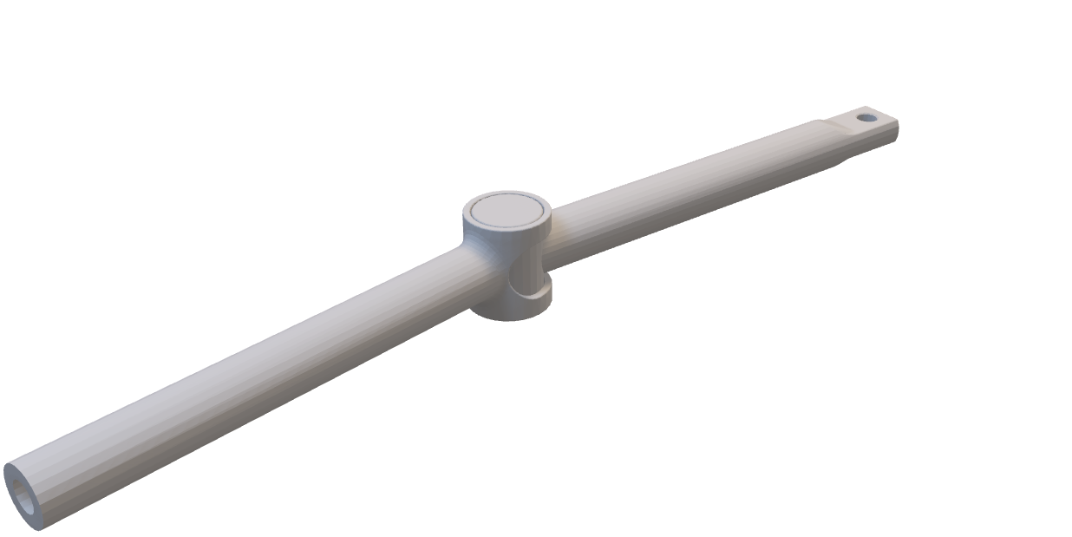
Mechanical Design and Iterations
Where we started – Iterration 1

Slide 7
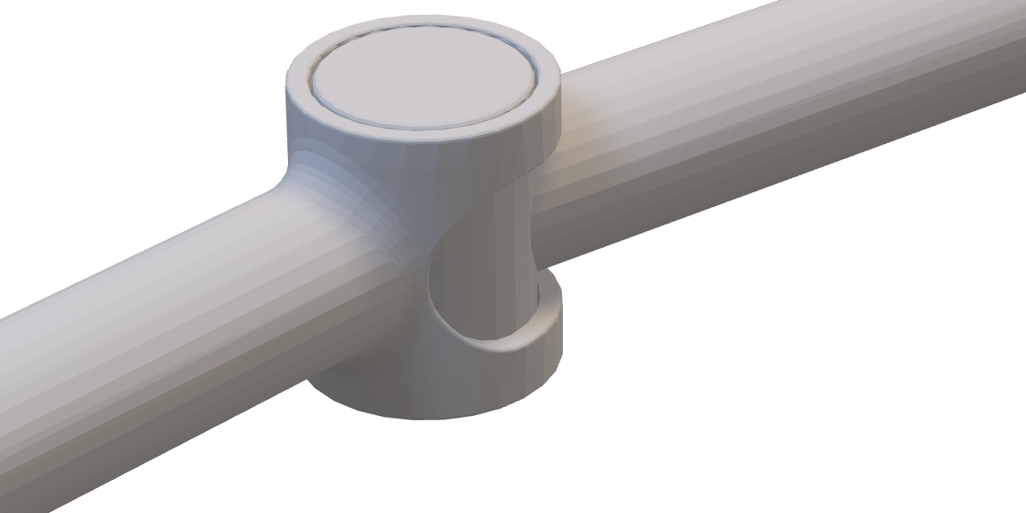
Mechanical Design and Iterations
Where we started – Iterration 1

Slide 8
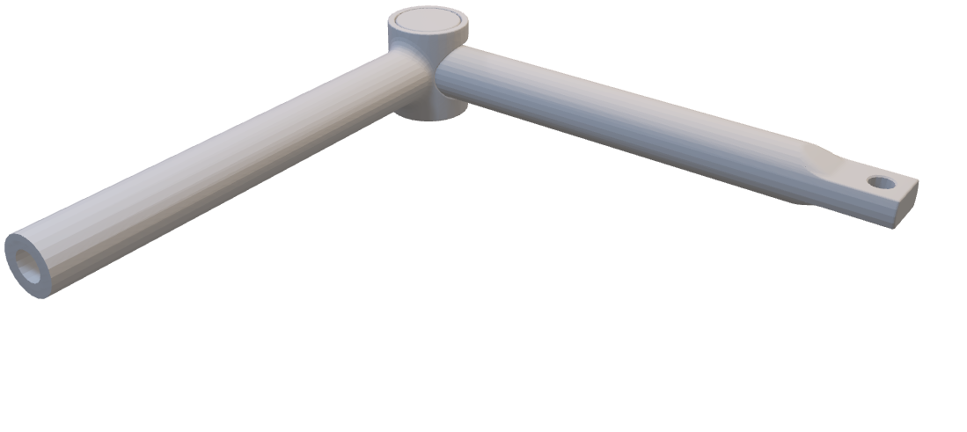
Mechanical Design and Iterations
Where we started – Iterration 1

Slide 9
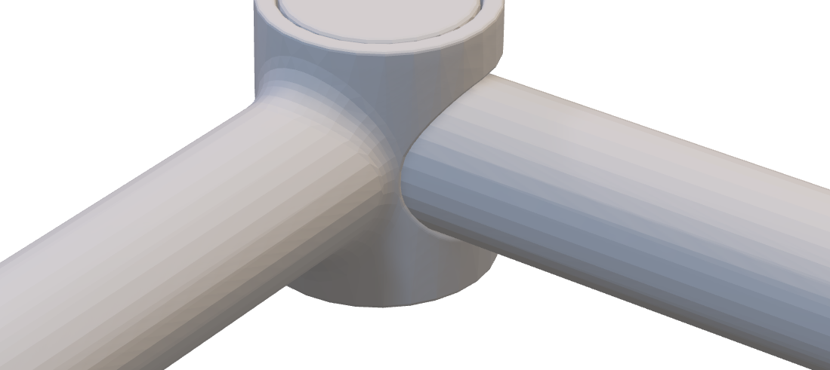
Mechanical Design and Iterations
Where we started – Iterration 1

Slide 10

Mechanical Design and Iterations
Where we started – Iterration 2

Slide 11
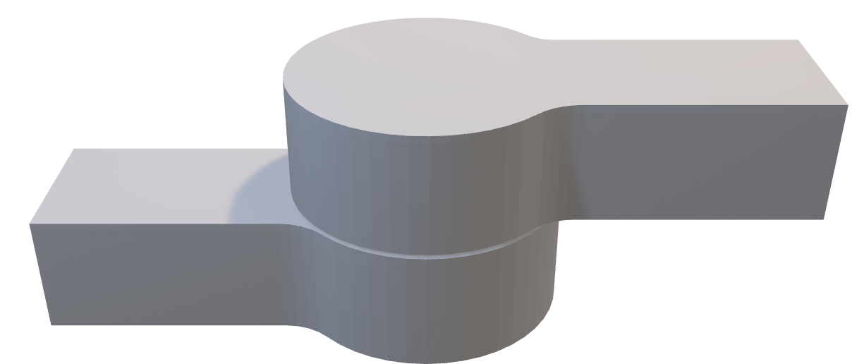
Mechanical Design and Iterations
Where we started – Iterration 2

Slide 12

Mechanical Design and Iterations
Where we started – Iterration 2

Slide 13

Mechanical Design and Iterations
Where we started – Final Design

Slide 14
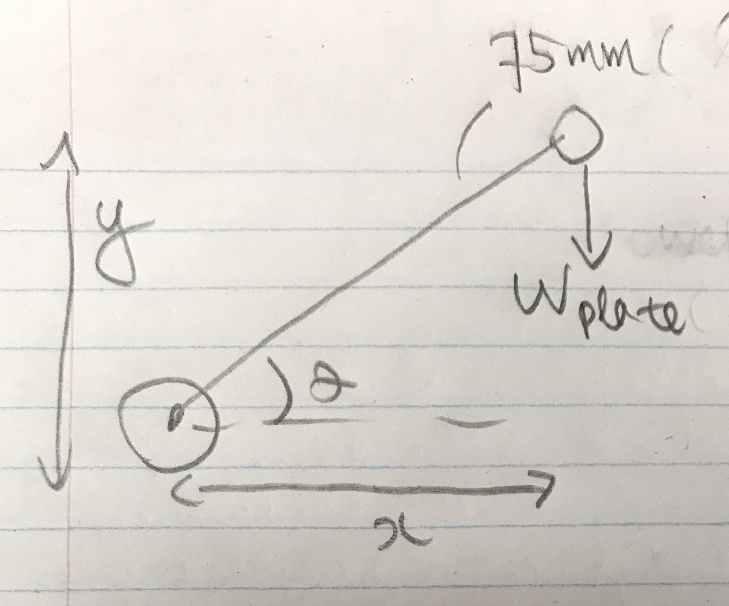
Electrical Design: Motor Selection​
Torque Calculations:
Force Analysis Diagram
Θ = 45° (Stall/resting angle)
X = (0.075)•cos(θ)
Y = (0.075)•sin(θ)
Wplate = Weight of the balancing plate = 5.15 N (3.s.f)
Balancing Plate torque (Approximation): Torque = Wplate•X = 2.79 kg-cm (3.s.f)

Slide 15
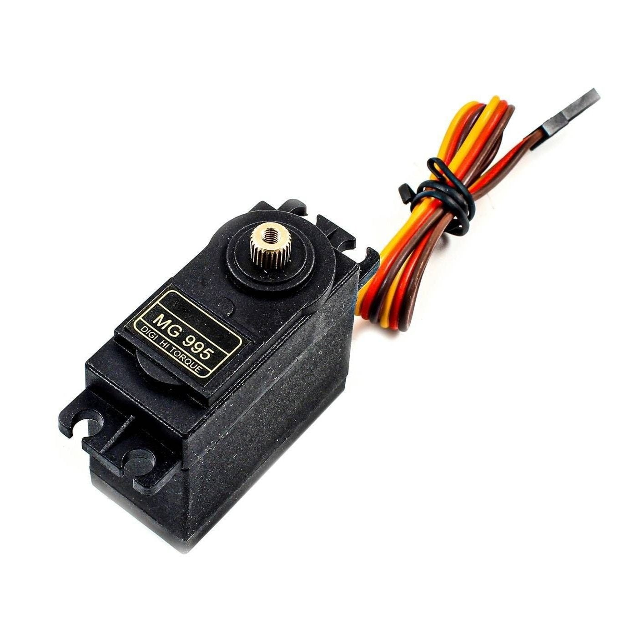
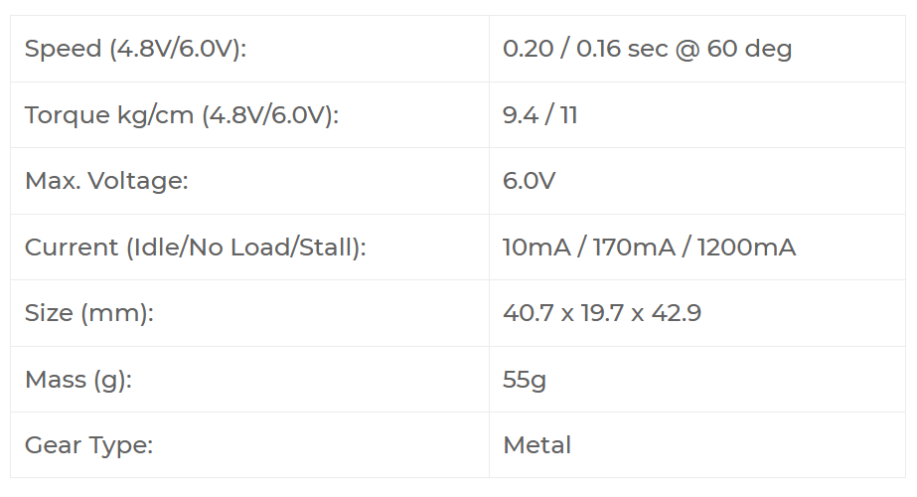
Electrical Design: Motor Selection
Initial Motor Selection:
MG 995 Servo Motor​
Friction between the joints could have increased the amount of torque required.
MG 995 servos are unable to properly lift-up the acrylic balancing plate
Concluded that these motors do not supply enough torque for the stewart platform
Torque calculation is performed to determine the amount of torque that the motor need to supply
Conclusion:
Select a motor with a higher torque rating

Slide 16
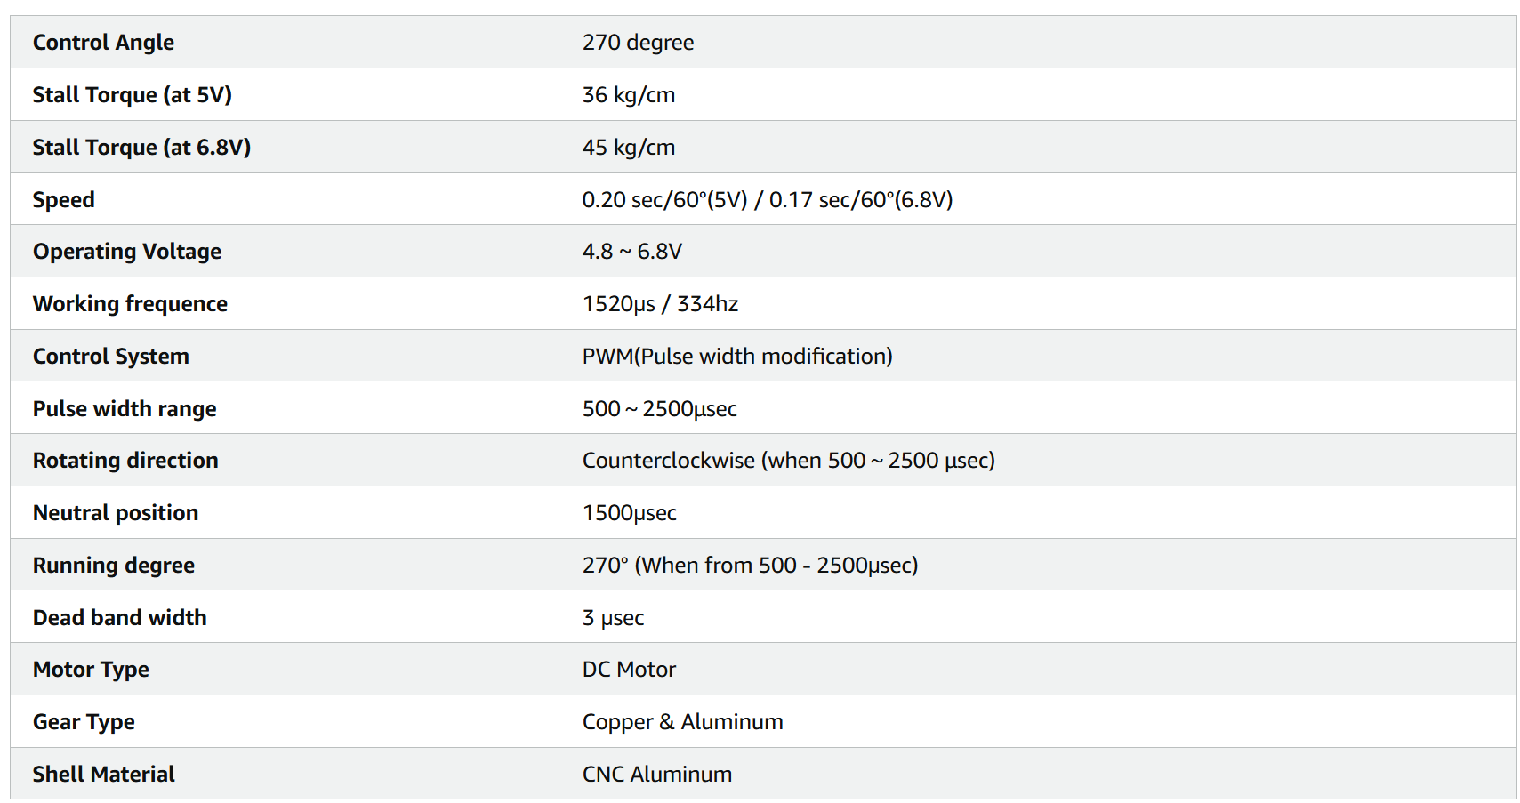
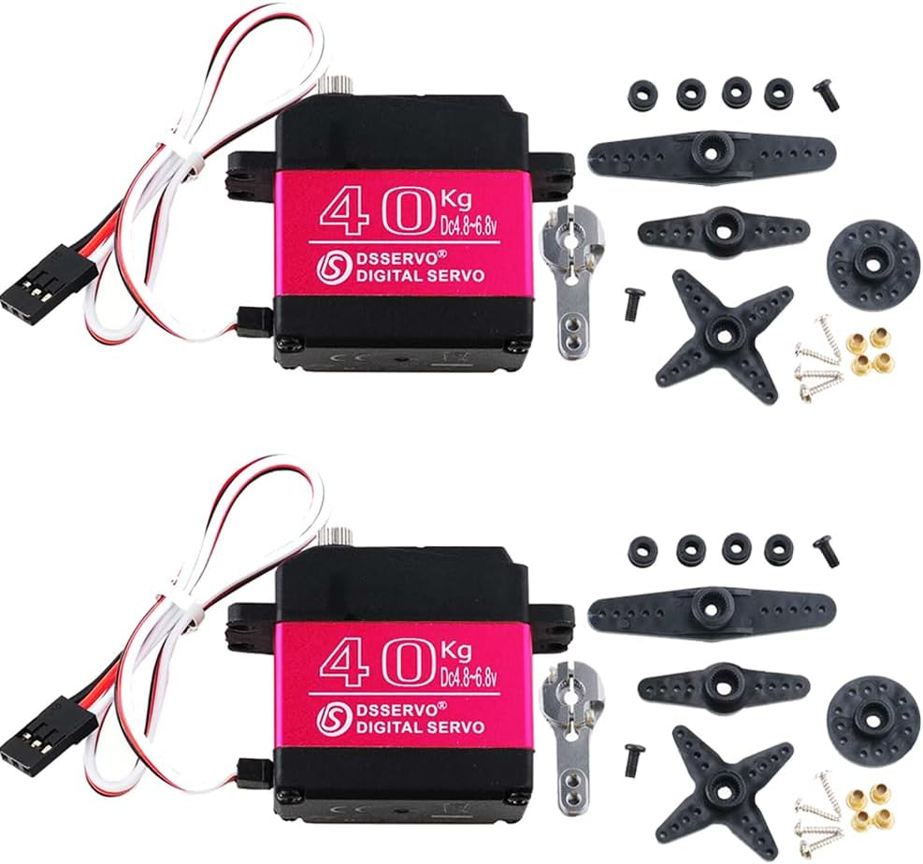
Electrical Design: Motor Selection
Final Motor Selection:
Stemedu 40KG Electric Servo
A new motor is selected with roughly identical dimensions to our previous motor
The new motor is capable of supplying significantly more torque (around 3 times of the original motor)
This allows us to account for the additional torque incurred from friction

Slide 17



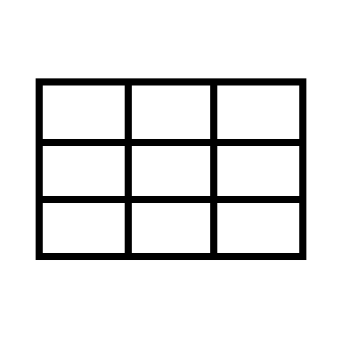
Software Design and Iterations – Key Points​
“Ghost” Point
CV
Find normal of opposite point (-x,-y) to determine tilt to return to center
Scrapped for PID controller as not scalable for velocity and disturbance control
Tuning color detection
Converted pixels to cm
Software Design
Lookup Table
Homing Design
System initially snail speed due to use of sympy equation solvers
Remove calculation time, replace with minimal data read-in
Servos
Use center of initial ball placement as origin

Slide 18
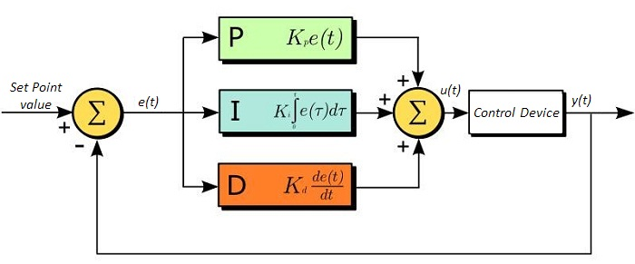
Controller Development
Initially, used kinematic equations to determine motor angles
Poor control over steepness of platform
Unable to account for momentum of ball
Moved to PID controller
Error in x and y are input
Angle along x-z and y-z plane were output
Extremely sensitive to controller parameters
Required multiple tuning attempts
https://www.thorlabs.com/newgrouppage9.cfm?objectgroup_id=9013
Notes:
Our controller design changed a couple times during this project. We first tried using the kinematic equations directly to compute the tilt of the platform, but we were unable to account for the momentum of the ball. This led to our next design of a PID controller, which took the ball’s position error to give the tilt of the platform. As we later found out, this type of controller is very sensitive to its control parameters and needed multiple tunes.

Slide 19





Control Cycle
Take Photo
Find Ball Position
Feed Error to PID
Lookup Motor Angles
Send Move Command
Notes:
Going over the control cycle briefly, our system first takes a photo of our platform with the ball on it. We process this photo using Open CV to get the ball position, which is then fed into the PID. Using the angles spit out by the PID, we look up the motor angles, which are finally sent to the Arduino for execution.

Slide 20
Lessons Learned
Aidan: “Always doubt the easy path, especially if there is only one source backing it up.”
Luke: “When you have the opportunity to start sooner, do that, even when other priorities feel more urgent.”
Leo: "Do not expect to create the perfect design from the very beginning. Always be prepared for multiple design iterations.“
Gavin: “Fail early and fail often.”
Marvin: “Think critically, but don’t overcomplicate simple solutions.”

Slide 22
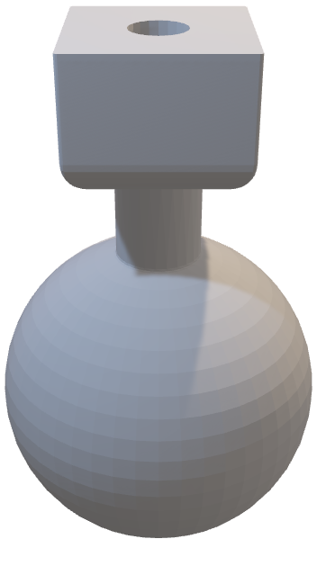
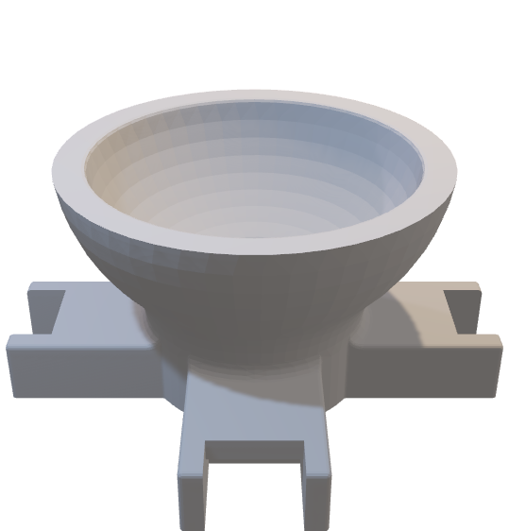
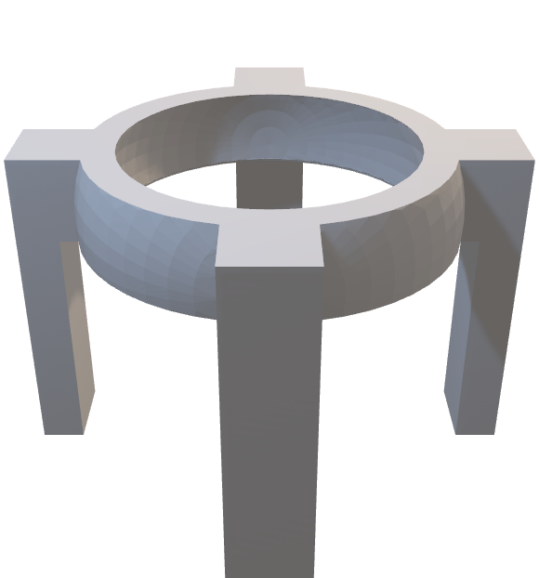
What Makes Our Platform Unique?
Standout Design Feature
3D Printed Ball Joint to Connect the Legs to the Platform:

